Slide 1

FPT University
Android programMing
Lesson 23
Version 1.0

Slide 2
Agenda
Handling Different Device Displays
Signing and Preparing an Android Application for Release

Slide 3
Handling Different Device Displays
Before being made available for purchase on the Google Play App Store, an application must first be submitted to the portal for review and approval. One of the most important steps to take before submitting an application is to decide which Android device models the application is intended to support and, more importantly, that the application runs without issue on those devices

Slide 4
Handling Different Device Displays
Handling Different Device Displays Android devices come in a variety of different screen sizes and resolutions. The ideal solution is to design the user interface of your application so that it appears correctly on the widest possible range of devices. The best way to achieve this is to design the user interface using layout managers that do not rely on absolute positioning
Notes:
Similarly, avoid using specific width and height properties wherever possible. When such properties are unavoidable, always use density-independent (dp) values as these are automatically scaled to match the device display at application runtime. Having designed the user interface, be sure to test it on each device on which it is intended to be supported. In the absence of the physical device hardware, use the emulator templates, wherever possible, to test on the widest possible range of devices. In the event that it is not possible to design the user interface such that a single design will work on all Android devices, another option is to provide a different layout for each display.

Slide 5
Handling Different Device Displays
Creating a Layout for each Display Size The ideal solution to the multiple display problem is to design user interface layouts that adapt to the display size of the device on which the application is running.
· res/layout – default layout · res/layout-sw200dp · res/layout-sw600dp · res/layout-sw800dp | · res/layout-small · res/layout-normal · res/layout-large · res/layout-xlarge · res/layout-land

Slide 6
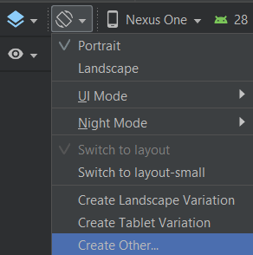
Handling Different Device Displays
Creating Layout Variants Android Studio makes it easy to add additional layout size variants using the Layout Variants button located in the Layout Editor toolbar

Slide 7
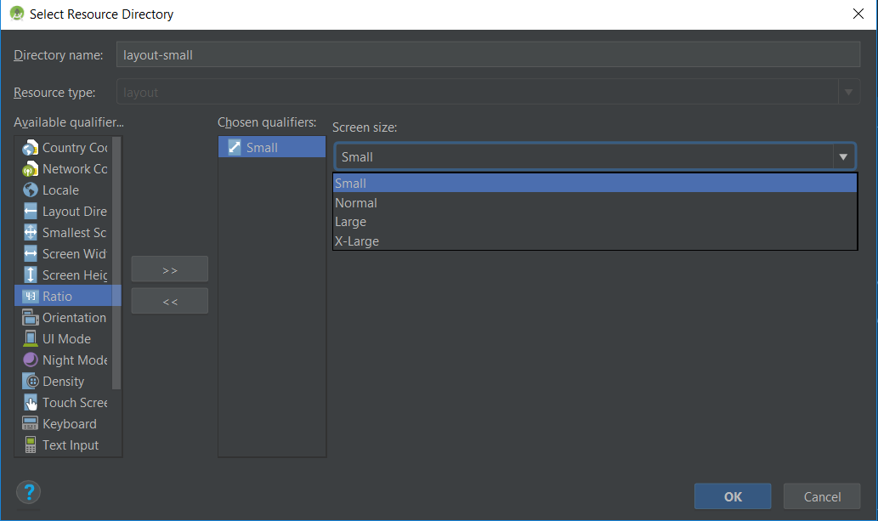
Handling Different Device Displays
Creating Layout Variants

Slide 8
Handling Different Device Displays
Providing Different Images
User interface layouts are not the only area of concern when adapting an application for different screen densities, dimensions and aspect ratios. Another area to pay attention to is that of images. An image that appears correctly scaled on a large tablet screen, for example, might not appear correctly scaled on a smaller phone based deivce.
· res/drawable-ldpi - Images for low density screens (approx. 120 dpi)
· res/drawable-mdpi – Images for medium-density screens (approx. 160 dpi)
· res/drawable-hdpi – Images for high-density screens (approx. 240 dpi)
· res/drawable-xhdpi – Images for extra high-density screens (approx. 320 dpi)
· res/drawable-tvdpi – Images for displays between medium and high density (approx. 213 dpi)
· res/drawable-nodpi – Images that must not be scaled by the system

Slide 9
Handling Different Device Displays
Providing Device Specific Application Binaries Even with the best of intentions, there will inevitably be situations where it is not possible to target all Android devices within a single application. In this situation, the application submission process allows multiple application binaries to be uploaded for a single application. Each binary is then configured to indicate to Google the devices with which the binary is configured to work

Slide 10
Signing and Preparing an Android Application for Release
Once the development work on an Android application is complete and it has been tested on a wide range of Android devices, the next step is to prepare the application for submission to the Google Play App Store. Before submission can take place, however, the application must be packaged for release and signed with a private key.

Slide 11
Signing and Preparing an Android Application for Release
The Release Preparation Process
compiled in release mode
signed with a private key
application package must be aligned

Slide 12
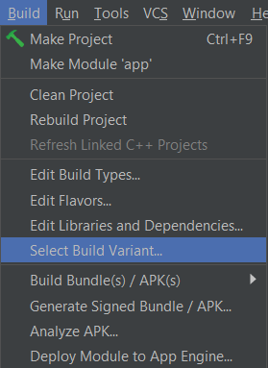
Signing and Preparing an Android Application for Release
Changing the Build Variant The first step in the process of generating a signed application APK file involves changing the build variant for the project from debug to release

Slide 13
Signing and Preparing an Android Application for Release
Enabling ProGuard When generating an application package, the option is available to use ProGuard during the package creation process. ProGuard performs a series of optimization and verification tasks that result in smaller and more efficient byte code. The steps to enable ProGuard are as follows:
Display the Project Structure dialog (File -> Project Structure).
Select the "app" module in the far left panel.
Select the "Build Types" tab in the main panel and the "release" entry from the middle panel.
Change the "Minify Enabled" option from "false" to "true" and click on OK

Slide 14
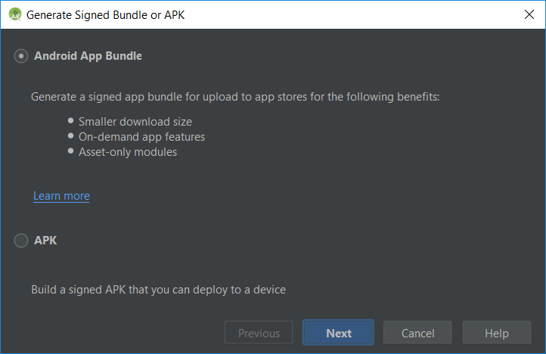
Signing and Preparing an Android Application for Release
Creating a Keystore File

Slide 15
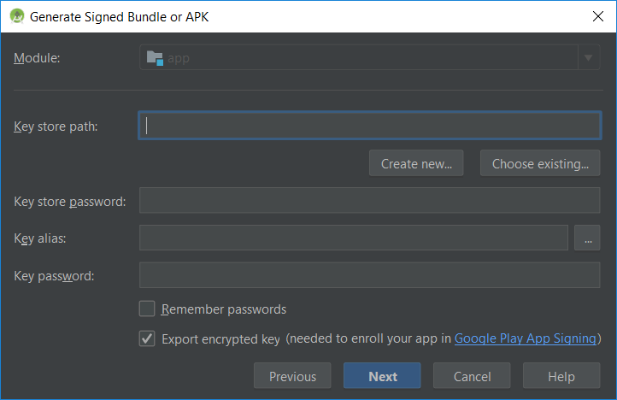
Signing and Preparing an Android Application for Release

Slide 16
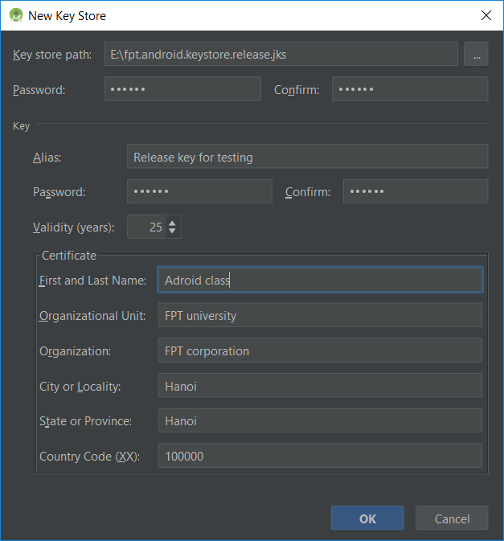
Signing and Preparing an Android Application for Release
Generating a Private Key

Slide 17
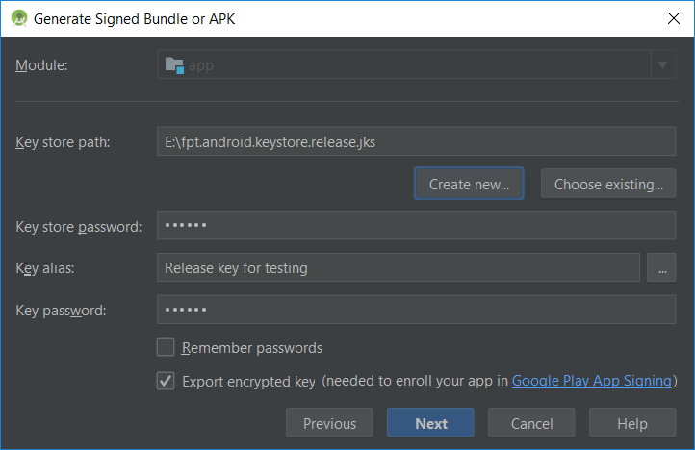
Signing and Preparing an Android Application for Release
Creating the Application APK File

Slide 18
Signing and Preparing an Android Application for Release
Register for a Google Play Developer Console Account The first step in the application submission process is to create a Google Play Developer Console account. To do so, navigate to https://play.google.com/apps/publish/signup/ and follow the instructions to complete the registration process. Note that there is a one-time $25 fee to register. Once an application goes on sale, Google will keep 30% of all revenues associated with the pplication

Slide 19
Signing and Preparing an Android Application for Release
Uploading New APK Versions to the Google Play Developer Console The first APK file uploaded for your application will invariably have a version code of 1. If an attempt is made to upload another APK file with the same version code number, the console will reject the file with the following error:
You need to use a different version code for your APK because you already have one with version code 1.

Slide 20
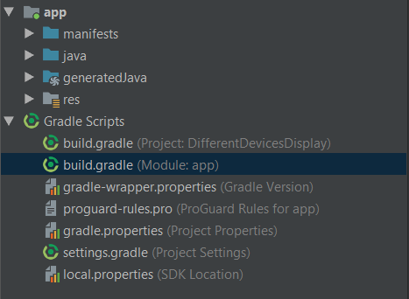
Signing and Preparing an Android Application for Release
How to change version code?

Slide 21
Signing and Preparing an Android Application for Release
android { compileSdkVersion 28 defaultConfig { applicationId "com.example.fpt.differentdevicesdisplay" minSdkVersion 26 targetSdkVersion 28 versionCode 1 versionName "1.0" testInstrumentationRunner "android.support.test.runner.AndroidJUnitRunner" } buildTypes { release { minifyEnabled true proguardFiles getDefaultProguardFile('proguard-android.txt'), 'proguard-rules.pro' } } }

Slide 22
Signing and Preparing an Android Application for Release
Analyzing the APK File Android Studio provides the ability to analyze the content of an APK file. This can be useful, for example, when attempting to find out why the APK file is larger than expected or to review the class structure of the application’s dex file.

Slide 23
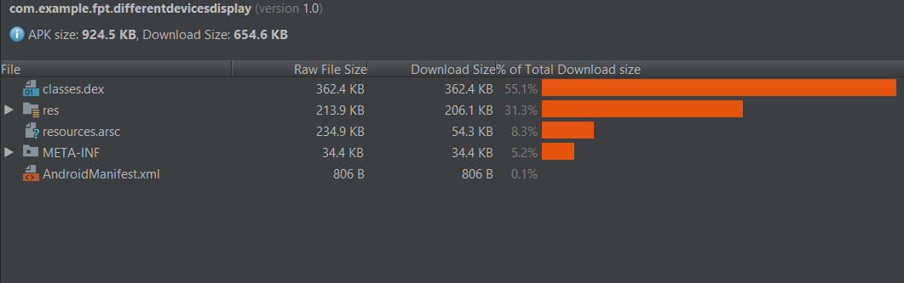
Signing and Preparing an Android Application for Release

Slide 24

End of Lesson 23

Slide 25
Thank you!

